Slide 1

Object Oriented Programming with Java
Chapter 5
Making Decisions

Slide 2
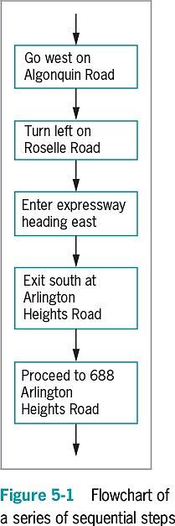
Planning Decision-Making Logic
Pseudocode
Use paper and a pencil
Plan a program’s logic by writing plain English statements
Accomplish important steps in a given task
Use everyday language
Flowchart
Steps in diagram form
A series of shapes connected by arrows
Programmers use a variety of shapes for different tasks
Rectangle to represent any unconditional step
Diamond to represent any decision
Sequence structure
One step follows another unconditionally
Cannot branch away or skip a step

Slide 3
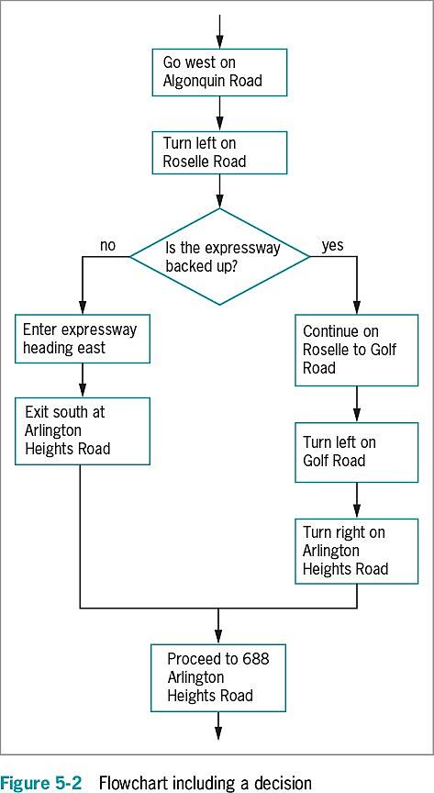
Planning Decision-Making Logic
Decision structure
Involves choosing among alternative courses of action
Based on some value within a program
All computer decisions are yes-or-no decisions
Boolean values
true and false values
Used in every computer decision

Slide 4
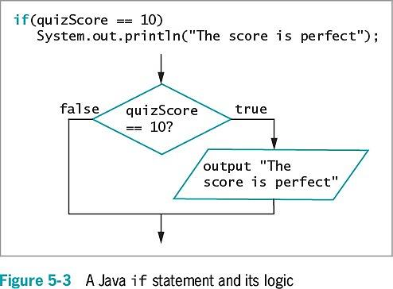
The if and if…else Statements
if statement
The simplest statement to make a decision
A Boolean expression appears within parentheses
Execution always continues to the next independent statement
Use a double equal sign ( == ) to determine equivalency

Slide 5
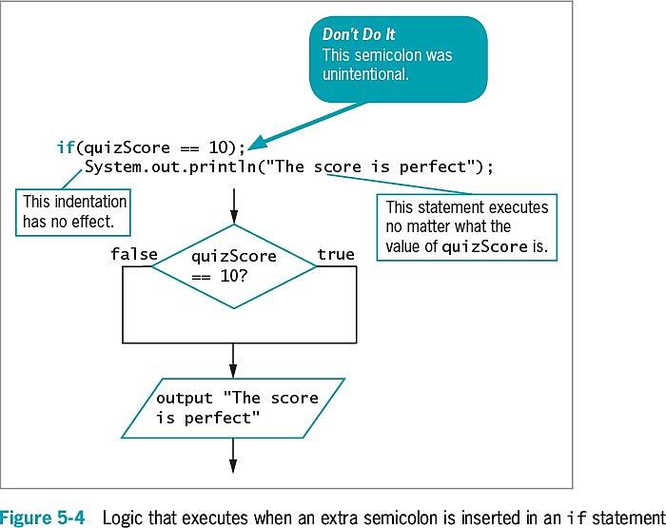
Pitfall: Misplacing a Semicolon in an if Statement
There should be no semicolon at the end of the first line of the if statement

Slide 6
Pitfall: Using the Assignment Operator Instead of the Equivalency Operator
Attempt to determine equivalency
Using a single equal sign rather than a double equal sign is illegal
You can store a Boolean expression’s value in a Boolean variable before using it in an if statement

Slide 7
Pitfall: Attempting to Compare Objects Using the Relational Operators
Use standard relational operators to compare values of primitive data types, Not objects
You can use the equals and not equals comparisons ( == and != ) with objects to compare objects’ memory addresses instead of values

Slide 8
The if…else Statement
Single-alternative : if
Perform an action, or not
Based on one alternative
if…else statement
Performs one action when a Boolean expression evaluates as true
Performs a different action when a Boolean expression evaluates as false
A statement that executes when if is true or false and ends with a semicolon
Vertically align the keyword if with the keyword else
Illegal to code else without if
Depending on the evaluation of the Boolean expression following if, only one resulting action takes place

Slide 9
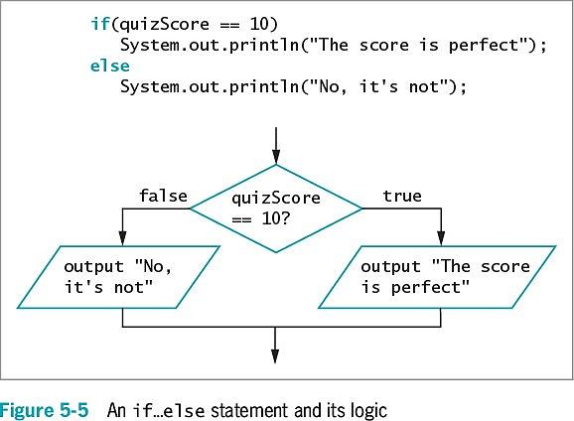
The if…else Statement

Slide 10
Using Multiple Statements in if and if…else Clauses
To execute more than one statement, use a pair of curly braces
Place dependent statements within a block
Crucial to place the curly braces correctly
Any variable declared within a block is local to that block

Slide 11
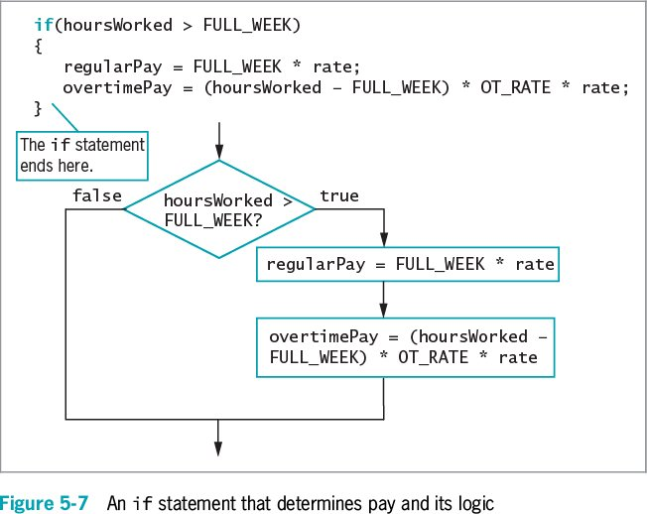
Using Multiple Statements in if and if…else Clauses

Slide 12
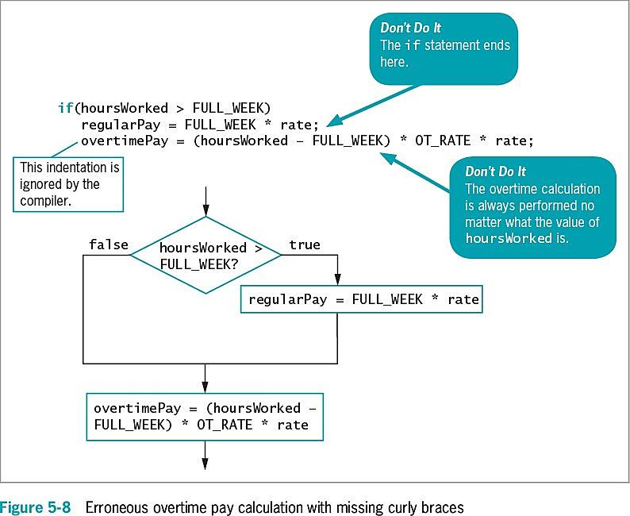
Using Multiple Statements in if and if…else Clauses

Slide 13
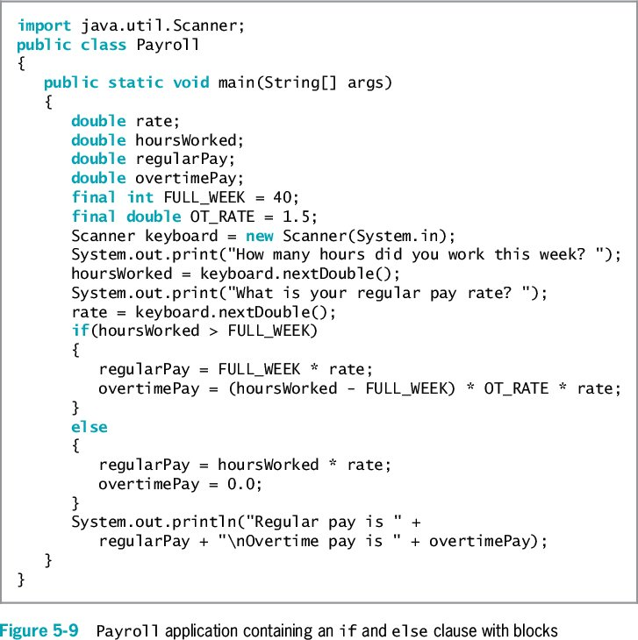
Using Multiple Statements in if and if…else Clauses

Slide 14
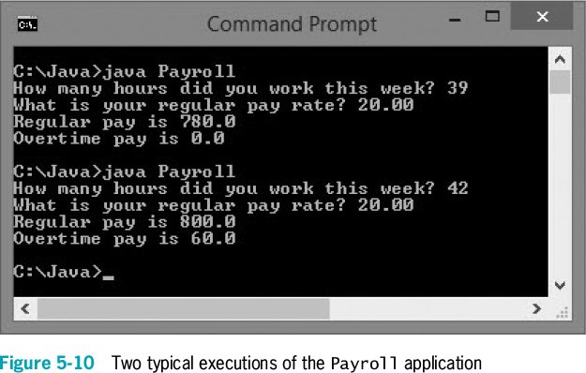
Using Multiple Statements in if and if…else Clauses

Slide 15
Nesting if and if…else Statements
Nested if statements
Statements in which an if structure is contained inside another if structure
Two conditions must be met before some action is taken
Pay careful attention to the placement of else clauses
else statements are always associated with if on a “first in-last out” basis

Slide 16
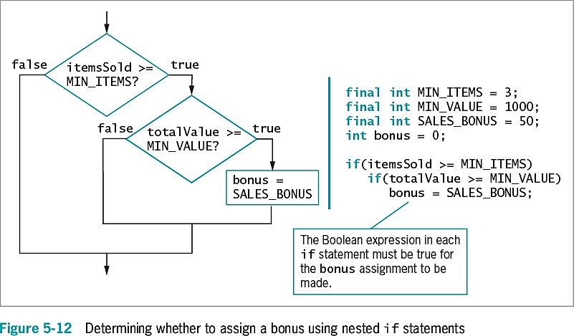
Nesting if and if…else Statements
Pay a $50 bonus to a salesperson only if the salesperson sells
at least three items with a total value of $1,000 or more.

Slide 17
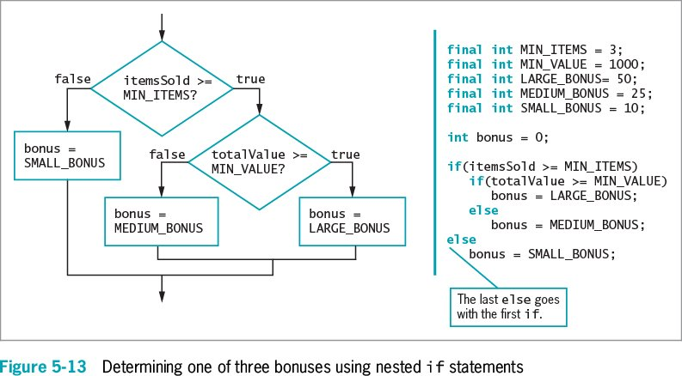
Nesting if and if…else Statements
$10 bonus for selling fewer than three items
$25 bonus for selling three or more items whose combined value is under $1,000
$50 bonus for selling at least three items whose combined value is at least $1,000

Slide 18
Using Logical AND and OR Operators
The logical AND operator
An alternative to some nested if statements
Used between two Boolean expressions to determine whether both are true
Written as two ampersands ( && )
Include a complete Boolean expression on each side
Both Boolean expressions that surround the operator must be true before the action in the statement can occur

Slide 19
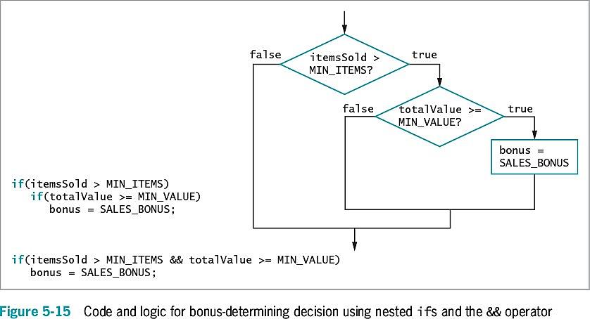
Using Logical AND and OR Operators

Slide 20
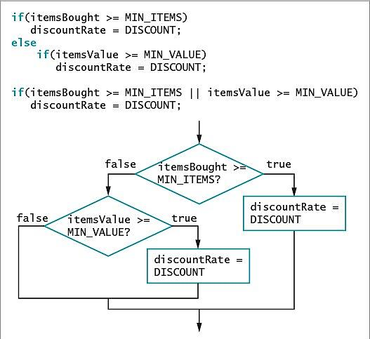
Using Logical AND and OR Operators
The OR operator
An action will occur when at least one of two conditions is true
Written as ||
Sometimes called “pipes”.

Slide 21
Using Logical AND and OR Operators
Short-circuit evaluation
Expressions on each side of the logical operator are evaluated only as far as necessary
Determine whether an expression is true or false

Slide 22
Making Accurate and Efficient Decisions
Making accurate range checks
Range check: a series of if statements that determine whether a value falls within a specified range
Java programmers commonly place each else of a subsequent if on the same line
Within a nested if…else statement:
It is most efficient to ask the most likely question first
Avoid asking multiple questions

Slide 23
Using && and || Appropriately
Errors of beginning programmers:
Using the AND operator when they mean to use OR
Example: No payRate value can ever be both less than 5.65 and more than 60 at the same time
if(payRate < LOW && payRate > HIGH)
System.out.println("Error in pay rate");
Use pipes “||” operator instead
Using a single ampersand or pipe to indicate a logical AND or OR

Slide 24
Using the switch Statement
switch statement
An alternative to a series of nested if statements
Test a single variable against a series of exact integer, character, or string values
Keywords
switch
Starts the structure
Followed by a test expression enclosed in parentheses
case
Followed by one of the possible values for the test expression and a colon
break
Optionally terminates a switch statement at the end of each case
default
Optionally is used prior to any action that should occur if the test variable does not match any case

Slide 25
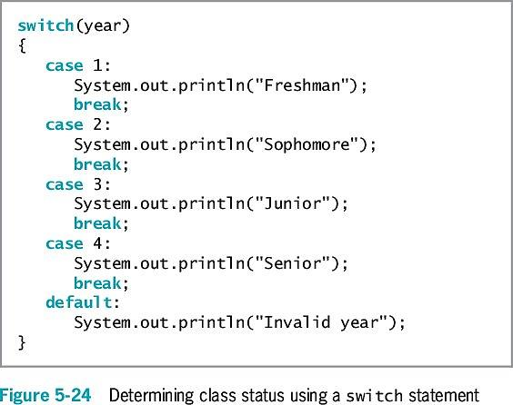
Using the switch Statement

Slide 26
Using the switch Statement
break statements in the switch structure
If a break statement is omitted:
The program finds a match for the test variable
All statements within the switch statement execute from that point forward
case statement
No need to write code for each case
Evaluate char variables
Ignore whether it is uppercase or lowercase

Slide 27
Using the switch Statement
Why use switch statements?
They are convenient when several alternative courses of action depend on a single integer, character, or string value
Use only when there is a reasonable number of specific matching values to be tested

Slide 28
Using the Conditional and NOT Operators
Conditional operator
Requires three expressions separated with a question mark and a colon
Used as an abbreviated version of the if…else structure
You are never required to use it
Syntax of a conditional operator:
testExpression ? trueResult : falseResult;

Slide 29
Using the Conditional and NOT Operators
A Boolean expression is evaluated as true or false
If the value of testExpression is true:
The entire conditional expression takes on the value of the expression following the question mark
If the value is false:
The entire expression takes on the value of falseResult
An advantage of using the conditional operator is the conciseness of the statement

Slide 30
Using the NOT Operator
NOT operator
Written as an exclamation point ( ! )
Negates the result of any Boolean expression
When preceded by the NOT operator, any expression evaluated as:
true becomes false
false becomes true

Slide 31
Understanding Operator Precedence
Combine as many AND or OR operators as needed
An operator’s precedence
How an expression is evaluated
The order agrees with common algebraic usage
Arithmetic is done first
Assignment is done last
The AND operator is evaluated before the OR operator
Statements in parentheses are evaluated first

Slide 32
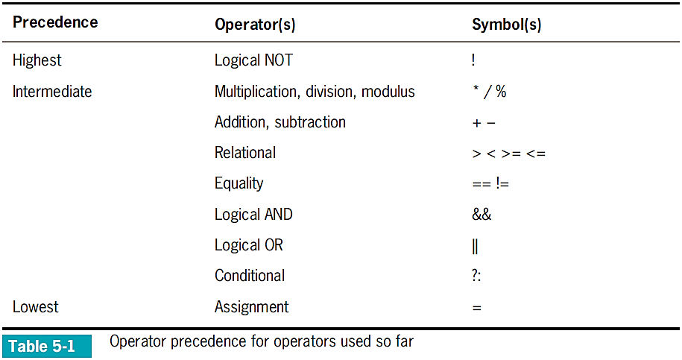
Understanding Operator Precedence

Slide 33
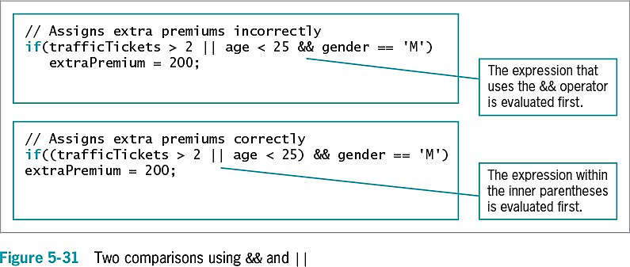
Understanding Operator Precedence
Two important conventions
The order in which operators are used makes a difference
Always use parentheses to change precedence or make your intentions clearer

Slide 34
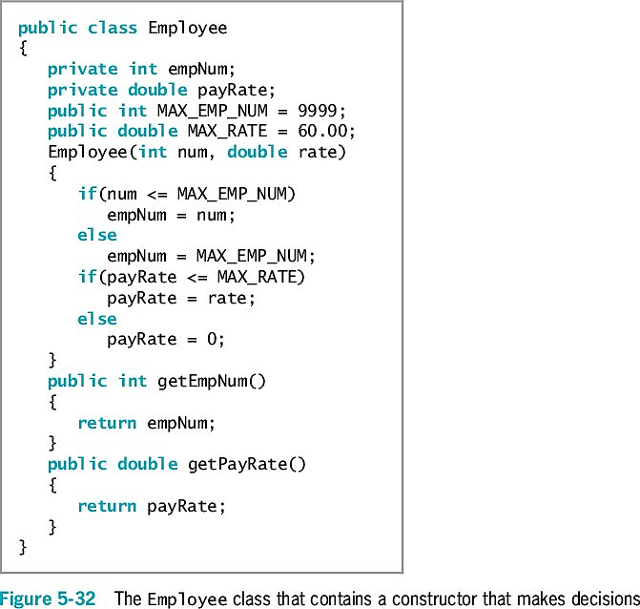
Adding Decisions and Constructors to Instance Methods
Helps ensure that fields have acceptable values
Determines whether values are within the allowed limits for the fields

Slide 35
Object Oriented Programming with Java
Chapter 6
Looping

Slide 36
Learning About the Loop Structure
Loop
A structure that allows repeated execution of a block of statements
Loop body
A block of statements
Executed repeatedly
Iteration
One execution of any loop

Slide 37
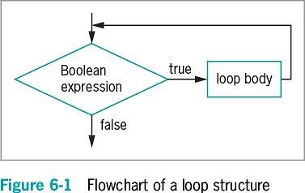
Learning About the Loop Structure
Three types of loops
while
The loop-controlling Boolean expression is the first statement
for
A concise format in which to execute loops
do…while
The loop-controlling Boolean expression is the last statement

Slide 38
Creating while Loops
while loop
Executes a body of statements continually as long as the Boolean expression that controls entry into the loop continues to be true
Consists of:
The keyword while
Followed by a Boolean expression within parentheses
Followed by the body of the loop; can be a single statement or a block of statements surrounded by curly braces

Slide 39
Writing a Definite while Loop
Definite loop
Performs a task a predetermined number of times
Also called a counted loop
Write a definite loop
Initialize the loop control variable
The variable whose value determines whether loop execution continues
While the loop control variable does not pass a limiting value, the program continues to execute the body of the while loop
Write a definite loop (cont’d.)
The body of the loop must include a statement that alters the loop control variable
Infinite loop
A loop that never ends
Can result from a mistake in the while loop
Do not write intentionally

Slide 40
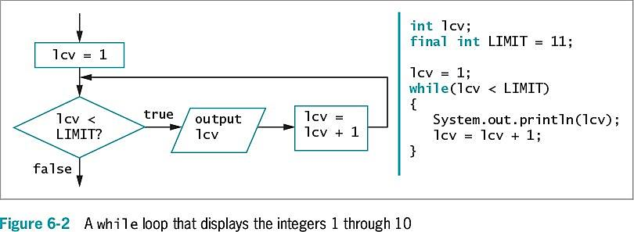
Writing a Definite while Loop

Slide 41
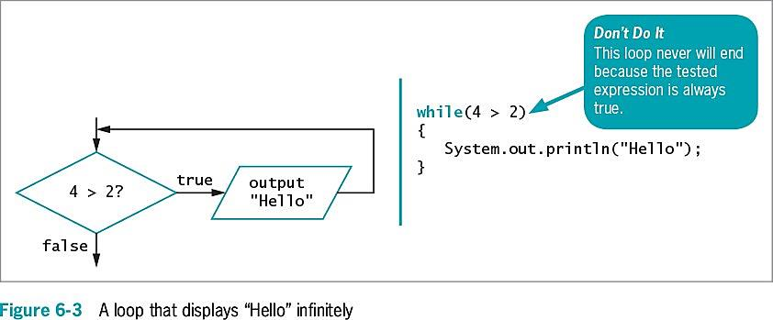
Writing a Definite while Loop

Slide 42
Writing a Definite while Loop
Suspect an infinite loop when:
The same output is displayed repeatedly
The screen remains idle for an extended period of time
To exit an infinite loop, press and hold Ctrl, then press C or Break

Slide 43
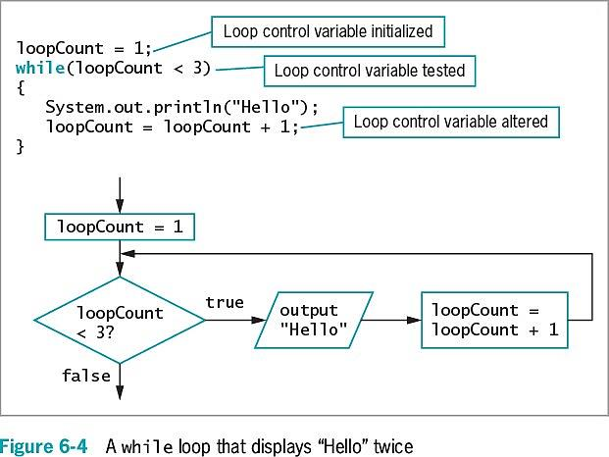
Writing a Definite while Loop

Slide 44
Pitfall: Failing to Alter the Loop Control Variable Within the Loop Body
Prevent the while loop from executing infinitely
The named loop control variable is initialized to a starting value
The loop control variable is tested in the while statement
If the test expression is true, the body of the while statement takes action
Alters the value of the loop control variable
The test of the while statement must eventually evaluate to false

Slide 45
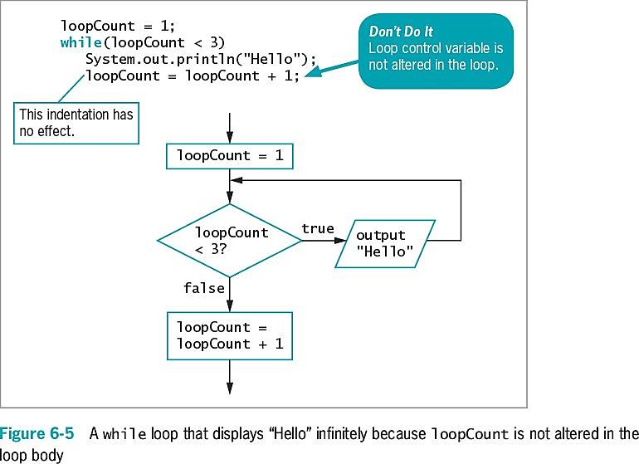
Pitfall: Failing to Alter the Loop Control Variable Within the Loop Body

Slide 46
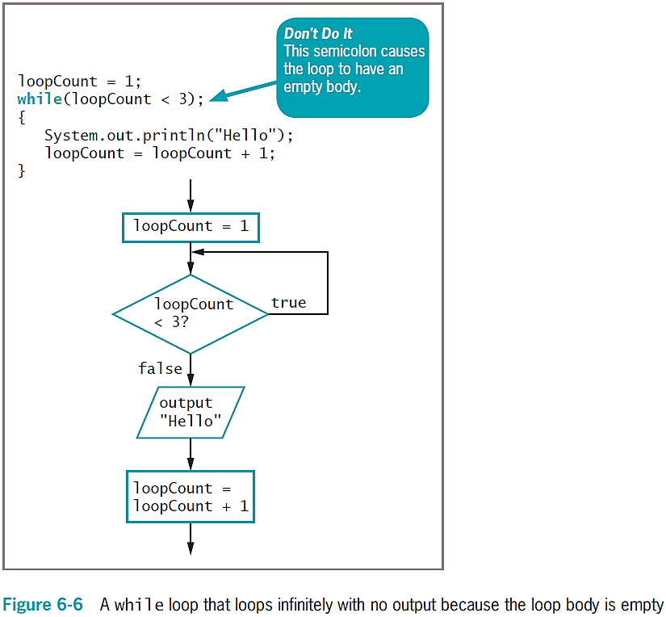
Pitfall: Unintentionally Creating a Loop with an Empty Body
Loop control variable
A variable that is altered and stored with a new value
loopCount = loopCount + 1
The equal sign assigns a value to the variable on the left
The variable should be altered within the body of the loop
Empty body
A body with no statements
Caused by misplaced semicolons

Slide 47
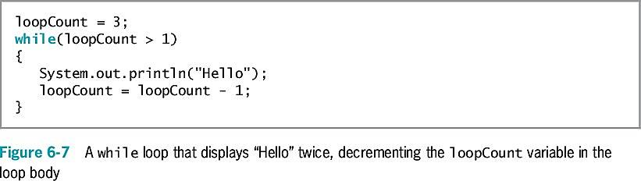
Altering a Definite Loop’s Control Variable
Incrementing the variable
Alter the value of the loop control variable by adding 1
Decrementing the variable
Subtract 1 from the loop control variable
Clearest and best method
Start the loop control variable at 0 or 1
Increment by 1 each time through the loop
Stop when the loop control variable reaches the limit

Slide 48
Writing an Indefinite while Loop
Indefinite loop
Altered by user input
Controlled by the user
Executed any number of times
Validating data
Ensure a value falls within a specified range
Use indefinite loops to validate input data
If a user enters incorrect data, the loop repeats

Slide 49
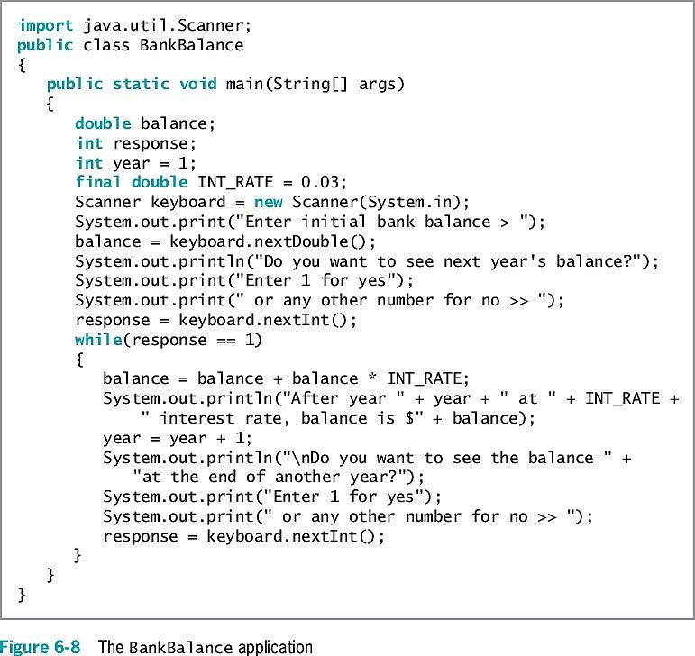
Writing an Indefinite while Loop

Slide 50
Validating Data
Ensuring data falls within a specific range
Priming read
Input retrieved before the loop is entered
Within a loop, the last statement retrieves the next input value and checks the value before the next entrance of the loop

Slide 51
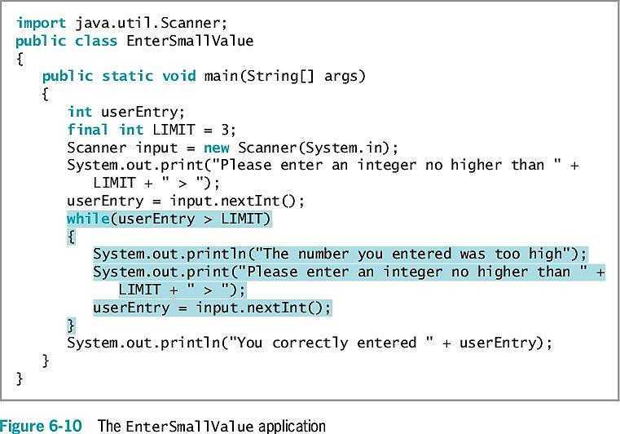
Validating Data

Slide 52
Using Shortcut Arithmetic Operators
Accumulating
Repeatedly increasing a value by some amount
Java provides shortcuts for incrementing and accumulating
+= add and assign operator
-= subtract and assign operator
*= multiply and assign operator
/= divide and assign operator
%= remainder and assign operator

Slide 53
Using Shortcut Arithmetic Operators
Prefix increment operator and postfix increment operator
++someValue, someValue++
Use only with variables
Unary operators
Use with one value
Increase a variable’s value by 1
No difference between operators (unless other operations are in the same expression)
What is the difference between the following two statements (int a = 2)?
int i = a++;
int j = ++a;

Slide 54
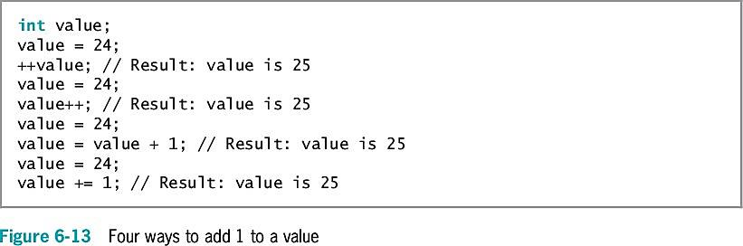
Using Shortcut Arithmetic Operators

Slide 55
Using Shortcut Arithmetic Operators
Prefix increment operator and postfix increment operator (cont’d.)
Prefix ++
The result is calculated and stored
Then the variable is used
Postfix ++
The variable is used
Then the result is calculated and stored
Prefix and postfix decrement operators
--someValue
someValue--
Similar logic to increment operators

Slide 56
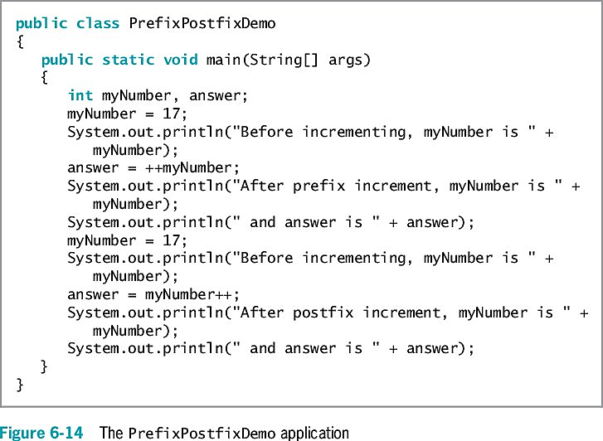
Using Shortcut Arithmetic Operators

Slide 57
Creating a for Loop
for loop
Used when a definite number of loop iterations is required
One convenient statement indicates:
The starting value for the loop control variable
The test condition that controls loop entry
The expression that alters the loop control variable

Slide 58
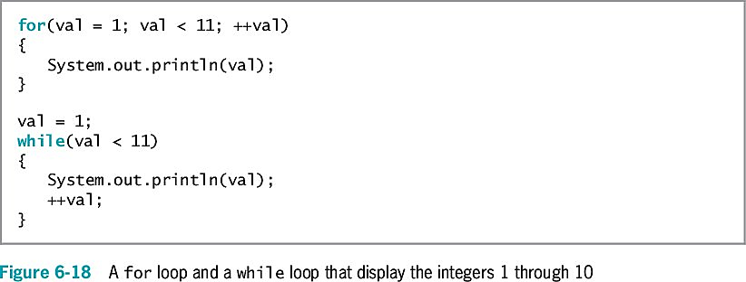
Creating a for Loop

Slide 59
Creating a for Loop
Other uses for the three sections of a for loop
Initialization of more than one variable
Place commas between separate statements
Performance of more than one test using AND or OR operators
Decrementing or performance of some other task
Altering more than one value
You can leave one or more portions of a for loop empty
Two semicolons are still required as placeholders
Use the same loop control variable in all three parts of a for statement
To pause a program:
Use the for loop that contains no body (do-nothing loop)
for(x = 0; x < 100000; ++x);
Or use the built-in sleep() method

Slide 60
Learning How and When to Use a do…while Loop
do…while loop
A posttest loop
Checks the value of the loop control variable
At the bottom of the loop
After one repetition has occurred
Performs a task at least one time
You are never required to use this type of loop
Use curly braces to block the statement
Even with a single statement

Slide 61
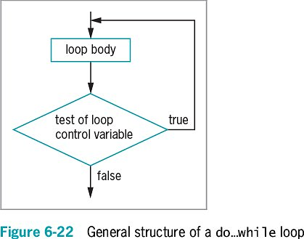
Learning How and When to Use a do…while Loop

Slide 62
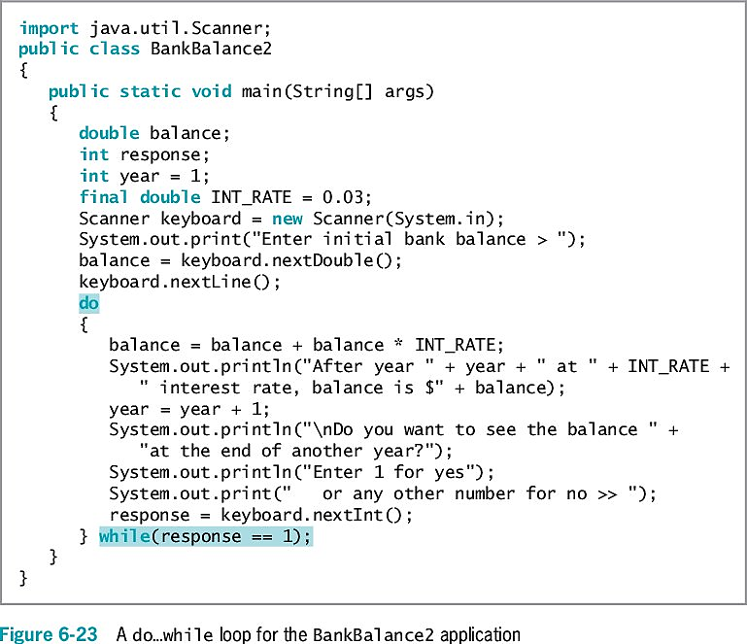
Learning How and When to Use a do…while Loop

Slide 63
Learning About Nested Loops
Inner loop and outer loop
An inner loop must be entirely contained in an outer loop
Loops can never overlap
To print three mailing labels for each of 20 customers:
for(customer = 1; customer <= 20; ++customer) {
for(color = 1; color <= 3; ++color) {
outputLabel ();
}
}

Slide 64
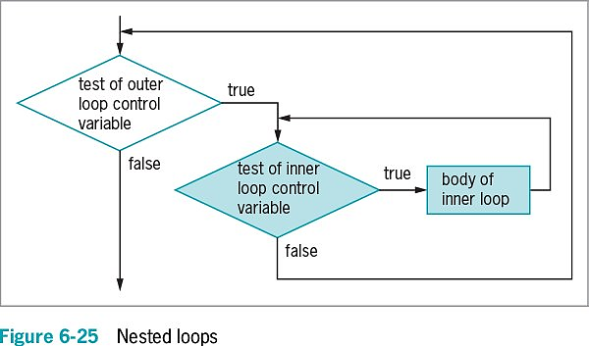
Learning About Nested Loop

Slide 65
Improving Loop Performance
Make sure a loop does not include unnecessary operations or statements
Consider the order of evaluation for short-circuit operators
Make comparisons to zero (0)
Combine loops
Do not use unnecessary operations or statements:
Within a loop’s tested expression
Within the loop body
Avoid:
while (x < a + b)
// loop body
Instead use:
int sum = a + b;
while(x < sum)
// loop body

Slide 66
Considering the Order of Evaluation of Short-Circuit Operators
Short-circuit evaluation
Each part of an AND or an OR expression is evaluated only as much as necessary to determine the value of the expression
Important to consider the number of evaluations that take place
When a loop might execute many times

Slide 67
Comparing to Zero
Making a comparison to zero (0) is faster than making a comparison to any other value
To improve loop performance, compare the loop control variable to zero (0)
Do-nothing loop
Performs no actions other than looping

Slide 68
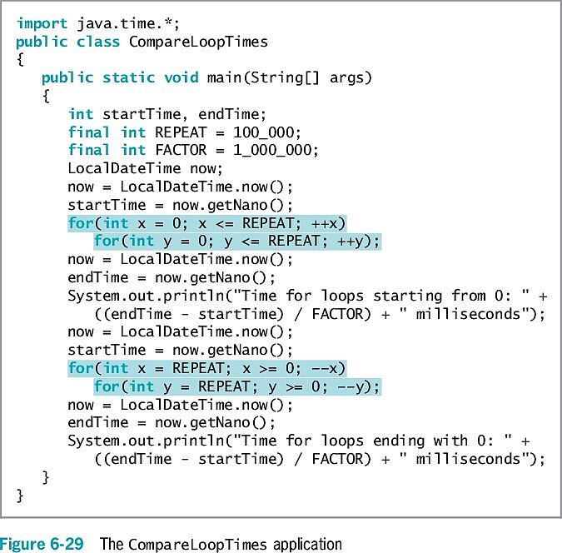
Comparing to Zero

Slide 69
Using Prefix Incrementing Rather than Postfix Incrementing
Prefix incrementing method
++x
When the method receives a reference to x, the value is increased and the increased value is returned
Postfix incrementing method
x++
When the method receives a reference to x, a copy of the value is made and stored
The value is incremented as indicated by the reference
The copy is returned
The extra time spent copying causes postfix incrementing to take longer

Slide 70
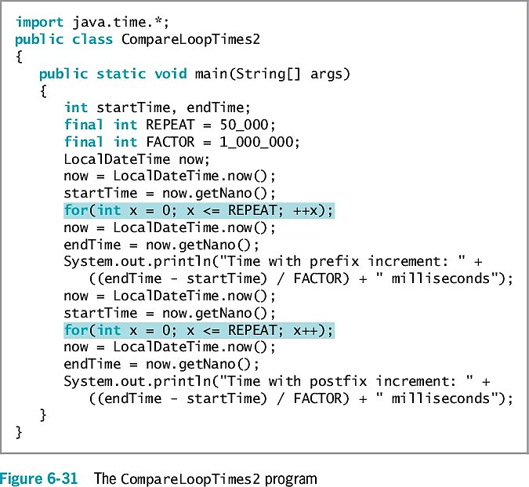
Using Prefix Incrementing Rather than Postfix Incrementing

Slide 71
Don’t Do It
Don’t insert a semicolon at the end of a while clause
Don’t forget to block {} multiple statements that should execute in a loop
Don’t repeat steps within a loop that could just as well be placed outside the loop

Slide 72
Summary
if statement
Makes a decision based on a Boolean expression
Single-alternative if
Performs an action based on one alternative
Dual-alternative if
if…else
Performs one action when a Boolean expression evaluates as true
Performs a different action when an expression evaluates as false
AND operator
&&
Determines whether two expressions are both true
OR operator
||
Carries out some action even if only one of two conditions is true
switch statement
Tests a single variable against a series of exact integer or character values
Conditional operator
An abbreviated version of an if…else statement
NOT operator
!
Negates the result of any Boolean expression

Slide 73
Summary Chapter 5
The loop structure allows repeated execution of a block of statements
Infinite loop
Definite loop
Nest loop
You must change the loop control variable within the looping structure
Use the while loop to execute statements while some condition is true
To execute the while loop
Initialize the loop control variable, test in the while statement, and alter the loop control variable
Prefix ++ and postfix ++
Increase a variable’s value by 1
The variable is used
The result is calculated and stored
Unary operators
Use with one value

Slide 74
Summary Chapter 6
Shortcut operators +=, -=, *=, and /=
Perform operations and assign the result in one step
for loop
Initializes, tests, and increments in one statement
do…while loop
Tests a Boolean expression after one repetition
Improve loop performance
Do not include unnecessary operations or statements

